Slide 1

GCIS-124
Software Development & Problem Solving
3: Inheritance

Slide 2

3.0
Accept the Assignment
You will create a new repository at the beginning of every new unit in this course. Accept the GitHub Classroom assignment for this unit and clone the new repository to your computer.
Your instructor will provide you with a new GitHub classroom invitation for this unit.
Upon accepting the invitation, you will be provided with the URL to your new repository, click it to verify that your repository has been created.
You should create a SoftDevII directory if you have not done so already.
Navigate to your SoftDevII directory and clone the new repository there.
Open your repository in VSCode and make sure that you have a terminal open with the PROBLEMS tab visible.

Slide 3


Asking for Help
Could be Improved
MUCH Better
I don't understand part 4.c. on the homework.
Part 4.c. on homework 2.2 asks us to write a function that prompts the user to enter two floating point values and to print the product.
I reviewed slides 17-18 in the lecture, and I finished the practice activity. That all works fine.
But when I try to use the values entered by the user, I am getting an "input mismatch" error. Does anyone have a suggestion?
You have all the resources that you need to solve the problems that have been given to you, but sometimes you may not be able to find the answers to the problems that you encounter.
Asking for help in this course is both expected and encouraged.
Spending time trying to solve the problem yourself will be a more valuable learning experience in the long run.
If you do ask for help, try to be as detailed as possible to make it easier for others to help you by providing as much detail as you can.
Begin by reviewing the lecture slides related to the problem that you are trying to solve
Try to solve the related class activities without looking at the answer
When asking for help, try to be as specific as possible about the problem you are having

Slide 4
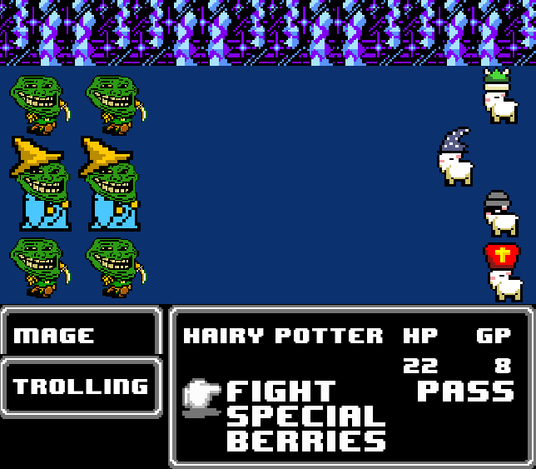
Inheritance
In the previous unit, we learned how to create classes in Java that include:
State (Fields)
Behavior (Methods)
Data privacy (Access Modifiers)
Constructors
Static and non-static state and behavior
During this unit we will learn about a very powerful feature of object-oriented programming: inheritance.
Subclassing
Overriding Methods
Polymorphism
Abstract Classes
Interfaces
Today we will specifically focus on reuse through subclassing.
One class inherits the state and behavior defined in another class.
The new class can then modify existing behavior or add new state and/or behavior.
We'll spend most of this unit using different types of inheritance to implement an RPG based on the classic Goats vs. Trolls CCG.
Notes:
Example Car, Donut

Slide 5


Goats vs. Trolls V: The Trolls Strike Back
The Goats vs. Trolls CCG has been so wildly successful that the powers that be have decided to expand the IP into a new video game inspired by the classic JRPGs of the 1980s. Your software development company has been contracted to develop the highly anticipated game. Goats vs. Trolls: The RPG. The player will control a party of 4 goats, as they battle against endless waves of enemy trolls. Your team will begin its design by focusing on the heroic Goats.
Type | Hit Points | Attack | Special
Mage | 120 | Magic Missile 9 (Magic Damage) hits 4 times | +25% physical damage taken -25% magical damage taken
Fighter | 150 | Cleave 25 (Physical Damage) | -25% physical damage taken +25% magical damage taken
As the screen above shows, GvTV will leverage modern hardware to enable its cutting edge graphics.
Notes:
In that screenshot, Hit Points (HP) represent a character’s health — how much damage they can take before being defeated.
From the table shown:
Mage: 120 HP
Fighter: 150 HP
What that means
Every time a goat takes damage, that damage is subtracted from its Hit Points.
When a character’s HP reaches 0, that character is defeated / knocked out.
The Fighter has more HP because it’s a frontline, physical-damage class, while the Mage is weaker defensively but stronger with magic.
So in short: 👉 Hit Points = total health / survivability of the character, and in this problem those values are 120 (Mage) and 150 (Fighter).
Mage – Attack Point Explained
Attack:
Magic Missile – 9 (Magic Damage), hits 4 times
Meaning:
Each Magic Missile hit does 9 magic damage
The attack hits 4 times
Total potential damage per attack:
9 × 4 = 36 magic damage
Mage – Special Explained
Special:
+25% physical damage taken
–25% magical damage taken
Meaning
If the Mage is hit by physical damage:
Damage is increased by 25%
If the Mage is hit by magic damage:
Damage is reduced by 25%

Slide 6
3.1
Simple Domain Analysis
Domain analysis is the activity of identifying and documenting the commonalities and variabilities in related software systems. Begin your design with a simple domain analysis.
Things to Note:
All goats have a name, e.g. “Hairy Potter.”
All goats can be healed for some of their hit points.
If a goats current HP drops to 0, the goat is knocked unconscious.
Class
State
Behavior
Notes:
Domain Analysis (big picture)
Domain analysis is the overall process of understanding what exists and how things behave in the problem space before you design or code.
It focuses on:
Key concepts/entities in the domain
Relationships between those concepts
Rules & constraints
Responsibilities and behaviors
Outputs often include:
Conceptual/class diagrams
Domain models
Identified business rules
Clarified terminology (ubiquitous language)
Noun–Verb Analysis (specific technique)
Noun–verb analysis is a heuristic used during domain analysis, especially early on.
How it works:
Nouns → candidate classes / attributes
Verbs → candidate methods / behaviors
Adjectives → attributes or constraints
Example sentence:
“Each ship has shields that recharge over time and weapons that deal damage.”
Nouns: Ship, Shield, Weapon, Damage
Verbs: recharge, deal
Adjectives: over time (constraint/behavior detail)
👉 It answers: “What classes and behaviors might exist?”

Slide 7
3.1
Simple Domain Analysis
Domain analysis is the activity of identifying and documenting the commonalities and variabilities in related software systems. Begin your design with a simple domain analysis.
Things to Note:
All goats have a name, e.g. “Hairy Potter.”
All goats can be healed for some of their hit points.
If a goats current HP drops to 0, the goat is knocked unconscious.
Class
State
Behavior
ATTACK
MAGE
FIGHTER
NAME
# OF HITS
DAMAGE TYPE
NAME
MAX HP
CURRENT HP
NAME
MAX HP
CURRENT HP
GETTERS
ATTACK
ATTACKED
HEAL
IS CONSCIOUS?
ATTACK
ATTACKED
HEAL
IS CONSCIOUS?

Slide 8


3.2
Damage Types
An attack in GvT may do one of several predefined types of damage. Define a Java enumeration that can be used to represent the different damage types in a game of GvT.
Create a new package under unit03 named "gvt". You will use this package for all of the code that you write today.
Create a new Java enum named "DamageType". Enumerate the possible values for damage types including:
Physical
Magical
Poison
Holy
Elemental
There is no need to test your new enum; you will be using it in the next activity.
Goat Mage’s Magic Missile attack does Magical damage...
...while Goat Fighter's Cleave attack does physical damage.

Slide 9
3.3
Plan of Attack
Attacks in GvT are too complex to be represented by a simple primitive type. Each attack has a name, a number of hits (each of which has its own damage amount), and a damage type. Create a new class to represent an attack.
Create a new Java class named "Attack". An attack includes:
A name, e.g. "Magic Missiles".
A variable number of hits, each of which is an integer value (hint: use an array).
A damage type.
Create a constructor that sets all three fields.
Create an accessor for each of the fields.
Once assigned, none of the values in an attack should ever change, so there is no need for any mutators.
The Mage's primary attack is "Magic Missiles." It hits 4 times for 9 points of magical damage.

Slide 10
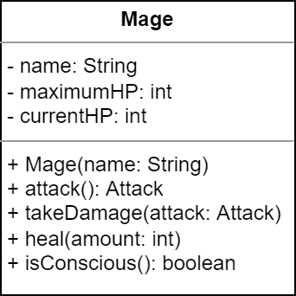

3.4
A Goat Mage
A professional software developer will design the software that they write first and then implement their design. Software developers must be able to read UML class diagrams and implement classes based on the design. Use the UML class diagram to begin implementing the Mage class.
Create a new Java class named "Mage" and begin implementing the class.
Add the necessary fields.
Create a constructor that initializes the name and sets the current and max HP to the default values (120).
Add a toString() that returns a String in the format "A mage named Hairy Potter with 120/120 hit points!"
Add a main method with the appropriate signature.
Create two instances of your new class.
Print the mages to standard output.

Slide 11
3.5
The Goat Mage (continued)
The Goat Mage is still missing some essential functionality. Mages can create Magic Missile attacks, can be attacked by other characters, and can be knocked unconscious. Finish implementing the Mage class now.
Use the UML as your guide to implement the remaining methods in the Mage class. Remember the following:
They can attack with "Magic Missiles," hitting 4 times for 9 points of magical damage.
They can heal for a specified number of hit points, but not above the max HP.
They may be unconscious if the current HP is at 0.
They can take damage from an attack which reduces their current HP, but not below 0. Remember that magical damage is reduced by 25% but physical damage is increased by 25%.
Use the main method to test your class.
Have your mages attack each other.
Print the mages to standard output after the attacks.
Notes:
Remember that magical damage is reduced by 25% → total damage affect is reduced by 25%

Slide 12
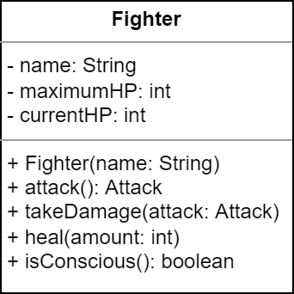

3.6
The Goat Fighter
GvT wouldn't be a very fun game with only one character class! Let's implement a new class to represent Goat Fighters.
Create a new Java class named "Fighter" and begin implementing the class. Hint: begin by copy/pasting your Mage code.
Use the UML as a guide.
Add fields and a constructor. The maximum HP should be 150.
Add the toString() method.
When implementing the Fighter's behavior:
They can attack with "Cleave," hitting once for 25 points of physical damage.
They can heal for a specified number of hit points, but not above the max HP.
They may be unconscious if the current HP is at 0.
They can take damage when from an attack which reduces their current HP, but not below 0. Remember that magical damage is increased by 25% but physical damage is reduced by 25%.
Add a main method with the appropriate signature.
Create two instances of your new class.
Print both to standard output.
Have your fighters attack each other, and print them to standard output after the attacks.

Slide 13
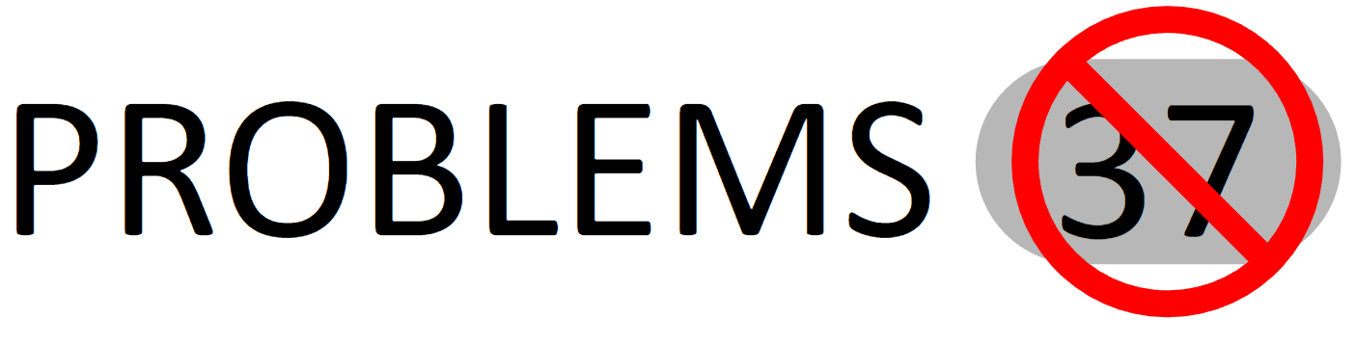

If VSCode has identified any problems, try to fix them. If you're not sure how, raise your hand and ask for help!
Whenever you see this image, it's a reminder to check your PROBLEMS tab.
And remember: it's not about avoiding making mistakes. It's about learning how to fix them as we make them.

Slide 14


3.7
Goat Fight Club
Now that we have a couple of goat character classes, let's put them to the test by creating an arena in which they can do battle!
Create a new Java class named "GoatArena" and define a static method named "battle" that declares parameter for goat1 (a Mage) and goat2 (a Fighter).
Have the two goats engage in an epic battle!
As long as both goats are conscious, have each goat attack the other in turn.
To be fair, both goats will always get to attack the other.
Be sure to print attacks and the status of each goat after each round.
Once the battle is over, determine the winner by checking to see which goat is still conscious.
Define a main method with the appropriate signature.
Make one of each type of goat and send them to battle.
Two goats enter. One goat leaves.
Notes:
Use Starter code

Slide 15
3.8
Mage Fight?
Who says that it always has to be a mage vs. a fighter in the arena? What if we wanted two mages to fight each other? Or what about two fighters?
Open the "GoatArena" and overload the "battle" method so that it declares parameters for goat1 and goat2 (both mages).
To speed things up, copy and paste the code from the other battle method.
If you make sure that the parameter names are the same, how much of the code do you need to change?
Use main to call the new battle function, this time with two mages.
Repeat the entire process, but this time both goat1 and goat2 should be fighters.
At this point, we have a lot of duplicated (or nearly duplicated code).
What happens if we add a Thief class? Or a Cleric? Or a Paladin?
Notes:
TALK A BIT ABOUT METHOD OVERLOAD
1. What happened if I want to fight between two mage.

Slide 16
Reuse
One of the major benefits of object-oriented programming is reuse.
Write code once, and use it in lots of places.
Reuse is an alternative to "copy and paste" coding, which duplicates the same code wherever it is needed.
There are many drawbacks to duplicating code, not the least of which is that it is wasteful, inefficient, and duplicates bugs.
Up to this point, the primary mechanism for reuse has been functions, but what if two different classes need the same functionality?
What if two or more classes implement the same behavior in exactly the same way?
What if two classes have identical state?
Object-oriented programming provides a core feature that allows different classes to reuse code: inheritance.
One class may extend another class to inherit its accessible state and behavior.
This creates a parent/child relationship between the two classes.
DRY
Don’t Repeat Yourself
DRY is a driving principle of software engineering that will be continuously emphasized.
Up until now, we have used functions to reuse code, but that technique will not work if two or more classes need the same functionality.
When using classes and objects, identical functionality in two or more classes may indicate an opportunity to leverage inheritance.
Notes:
So far we discussed, moving repeated code to a function
What about code is being repeated across different class.
What if two or more classes implement the same behavior in exactly the same way?
Object-oriented programming provides a core feature that allows different classes to reuse code: inheritance.
One class may extend another class to inherit its accessible state and behavior.
This creates a parent/child relationship between the two classes.

Slide 17
3.9
Identifying Common Attributes
We will be creating a new parent class to contain all of the fields and methods that our two goats have in common. Let's start by identifying what those are!
 | Common to Both | Unique to Mage | Unique to Fighter
State
Behavior
You may find it useful to open the two classes side-by-side in your editor (i.e. split to the right).

Slide 18
3.9
Identifying Common Attributes
We will be creating a new parent class to contain all of the fields and methods that our two goats have in common. Let's start by identifying what those are!
 | Common to Both | Unique to Mage | Unique to Fighter
State
Behavior
NAME
MAX HP
CURRENT HP
MAX_HP
MAX_HP
You may find it useful to open the two classes side-by-side in your editor (i.e. split to the right).
CONSTRUCTOR
ACCESSORS
HEAL
IS CONSCIOUS
ATTACK
TAKE DAMAGE
ATTACK
TAKE DAMAGE

Slide 19

A Common Goat
The Mage and Fighter classes share all of the same state:
Name, Max HP, Current HP
Both classes also implement some of the exact same behavior:
Very similar constructors.
Accessors for name, current HP, & Max HP.
Methods for healing and consciousness.
We will create a class that encapsulates all of the common state and behavior so that the Mage and Fighter classes can reuse it.
We'll see exactly how to do this presently.
The process of identifying common state and behavior and putting it into a parent class is called creating an abstraction.
COMMON STUFF GOES HERE
UNIQUE/DIFFERENT STUFF GOES HERE

Slide 20


3.10
A Common Goat
Inheritance allows one class to reuse the accessible state and behavior defined by another class so that we don't need to copy-and-paste it in multiple places. Let's create a new Goat class that contains all of the common attributes of the Mage and Fighter classes.
Create a new Java class named "Goat" and use it to encapsulate all of the common state and behavior between your two existing goat classes.
Copy/paste all of the code from one of the two goat classes.
Update the name of the constructor.
How should you handle the attack and take damage methods?
All goats need both of these methods.
But there is no common implementation.
Not all heroes wear capes. And not all goats wear hats.
Notes:
Use Mage to copy all the code.
When you are building a new class by extracting common functionality, ensure that parent and child share common characteristics, build on similar concepts
Goat → Mage / Fighter
Boat → Car just because they both run on gas. They are totally different things / concepts

Slide 21
Inheritance
A child class inherits the accessible state and behavior of its parent class.
Private members are not inherited.
Child classes do inherit protected members.
Constructors are not inherited. The child class must define its own.
This means that an instance of the child class can reuse the state and behavior in its parent.
This includes accessible fields in the parent class.
This also includes any accessible methods in the parent class.
Inherited state and behavior can be accessed through the child using dot notation.
This also means that an instance of the child class can be used anywhere the parent is expected.
For example, an instance of the child class may be passed as an argument to a method that declares a parameter of its parent's type. Code inside the method can use any of the state and behavior defined by the parent.
This is a core object-oriented concept known as polymorphism.
In Java, a child class uses extends to establish an inheritance relationship with a parent class.
e.g. public class Child extends Parent
Parent
- fields
+ methods
Child
- more fields
+ more methods
Remember, arrows in UML indicate the direction of dependency. Because the child depends on the parent (and not the other way around), inheritance in UML is depicted with a closed arrow (that is not filled) that points from the child to the parent.
Notes:
Every Mage is goat
Every goat is not mage.
RIT,
Human – Prof. , Student
Only Prof. and Student is allowed in the classroom → Not everybody allowed
All Humans are allowed → Everybody allowed

Slide 22
super & Access Modifiers
We already know that an object uses this to refer to itself and use its own state and behavior. It can be used in several different ways, e.g.:
Setting fields: this.name = name;
Chaining constructors: this(name, age);
Invoking methods: this.getName();
Similarly, an object uses super to access state and behavior defined by its parent class, e.g.
Invoke a constructor: super(x, "white");
Access fields: return super.name;
Calling methods: super.getAge();
Constructors are not inherited from the parent class; the child must define its own and call one of the parent constructors using super.
The exception is that if the parent class has a default or parameterless constructor, in which case it will be invoked transparently by default if no other constructor is explicitly called.
A child class can only use super to access accessible state and behavior in its parent class. Accessibility to the child is determined by the access modifier used with each field, method, and constructor.
What has access? | private | none (package private) | protected | public
Instances of the same class
Classes in the same package
Child Classes
Everything
✔
✔
✔
✔
✔
✔
✔
✔
✔
✔

Slide 23
Inheritance Example
public class Animal {
private String name;
private double weight;
public Animal(String name, double weight) {
this.name = name;
this.weight = weight;
}
public String toString() {
return "Animal[name=" + name
+ ", weight=" + weight + "]";
}
public String getName() {
return name;
}
public void greet(Animal o) {
System.out.println(name + " greets "
+ o.name + "!");
}
}
Child classes use extends to create an is-a relationship with a parent class.
public class Rabbit extends Animal {
private String furColor;
public Rabbit(double weight,
String furColor) {
super("Rabbit", weight);
this.furColor = furColor;
}
public void move() {
System.out.println(super.name
+ " goes hop, hop, hop!");
}
}
Constructors are not inherited. A child class must define its own constructors and call one of the parent constructors using super.
Use getName() instead.
Child classes cannot directly access private state or behavior in the parent class. Accessors and mutators will need to be used.
Rabbit r = new Rabbit(2.5, "brown");
Animal a = new Rabbit(3, "white");
a.greet(r);
Through subclassing, Rabbit "is a" Animal, and can be used with any code written to use Animal. Polymorphism!
Notes:
The caveat regarding constructors is the a default or parameterless constructor in the parent will be automatically invoked if it exists and no other constructor is explicitly called by the child.
Here you can’t call a.move() because Animal class does not know about move method.
So you need to convert animal class back to Rabbit
((Rabbit)a).move()

Slide 24
3.11
Begin Refactoring Mage
Now that you have encapsulated all of the common state and behavior in the Goat class, refactor Mage so that it extends Goat.
Open your Mage class and modify it so that it subclasses your common Goat. For now we will focus only on the constructor.
Begin by commenting all but the main method in the body of the class.
Use extends to establish the inheritance relationship with Goat.
Try to compile and run the class.
Compilation will fail because you have not yet defined a constructor.
Add a constructor to your Mage class that uses super to call the constructor in the parent class.
What parameters will your Mage constructor need? Hint: some values never change from one Mage to the next.
Compile and run the class again.
Does the main method still work the way that you expect it to?
public class Animal {
private String name;
private double weight;
public Animal(String name,
double weight) {
this.name = name;
this.weight = weight;
}
}
public class Rabbit extends Animal {
private String furColor;
public Rabbit(double weight,
String furColor) {
super("Rabbit", weight);
this.furColor = furColor;
}
}
Notes:
Update Goat to include maximum hit point.
Also, Create a constants class to define all constants.

Slide 25
Overriding Methods
Inheritance enables polymorphism, which means that any code written to use the parent will also work with any of its children.
This is because the child class inherits all of the accessible state and behavior from its parent.
This means that any code that uses state and behavior defined in the parent class will find the same state and behavior in the child as well.
Conversely, this means that state and behavior that is not defined in the parent, cannot be used via polymorphism.
If the method only exists in the child class, then it can't be used through a variable of the parent type.
This means that we sometimes define methods in the parent to guarantee that all children will include them.
In these cases, the child may modify or replace the behavior that is defined in its parent.
The child class overrides the method in the parent class by defining a new method with the exact same signature.
If the method is called on an instance of the child class, the child's version is used instead of the parent's.
If necessary, the child can call the parent's version suing super, e.g. super.aMethod();
The toString() method in the Animal class returns a String that doesn't include all of the detail about a Rabbit (i.e. its fur color is missing).
The Rabbit class may override the implementation of the method in the Animal class by declaring a new implementation with the exact same signature.
1 public class Rabbit extends Animal {
2 // other fields, constructors, and methods
3 // are not shown here for brevity
4
5 @Override
6 public String toString() {
7 return "Rabbit[weight=" + getWeight()
8 + ", fur color=" + furColor + "]";
9 }
10 }
If the optional @Override annotation is used, the Java compiler will validate the method signature.
If the method is called on an instance of the Rabbit class, its version will be used instead of Animal's.
Notes:
Conversely, this means that state and behavior that is not defined in the parent, cannot be used via polymorphism.

Slide 26
3.12
Finish Refactoring Mage
One major benefit of inheritance is that we can eliminate duplicate code. Continue refactoring the Mage class to override methods and delete any duplicate code should be inherited from Goat.
public class Animal {
private String name;
private double weight;
public Animal(String name,
double weight) {
this.name = name;
this.weight = weight;
}
}
Open your Mage class and examine the code that you have commented out and selectively delete or uncomment it.
Which fields can safely be deleted?
Which methods can safely be deleted?
Which methods do you need to keep to override the same methods in the Goat class? Don't forget to use the @Override annotation!
Compile and run the class.
Does the main method work the way that you expect it to?
public class Rabbit extends Animal {
private String furColor;
public Rabbit(double weight,
String furColor) {
super("Rabbit", weight);
this.furColor = furColor;
}
}
Notes:
All instance field not needed.
All accessor not needed.
Attack & Take damage need to be overwritten
Need to define the mutator for setting hp

Slide 27

3.13
Refactor Fighter
The Mage class is now making effective use of inheritance to reuse the state and behavior from its new parent class. Unfortunately, Fighter still has a lot of duplicate code! Let's refactor the Fighter class to extend Goat now.
Open the Fighter class and modify it so that it subclasses your common Goat.
Use extends to establish the inheritance relationship.
You will need to write at least one constructor. Use super to call the parent constructor.
Which methods can be safely deleted?
Which methods will override the implementations in the parent class?
Experiment by running the class. Does the main method still work?

Slide 28
Polymorphism
When one class extends another, it inherits all of the accessible state and behavior from the parent class.
The subclass can be used with any code that has been written to use the superclass.
This is because any code that uses state and behavior defined by the parent will find that same state and behavior in the child.
This is a key feature of object-oriented programming that is known as polymorphism: code written to use a parent will work with any of its children.
However, there is another equally important aspect of polymorphism: if a child is used in place of its parent and the child overrides the methods in the parent, the child's version of those methods will be used.
The declared type of a variable determines the state and behavior that can be used through that variable.
The assigned type determines the implementation that is used.
For example, Parent p = new Parent(); will assign an instance of the Parent class to the variable, and its methods will be used regardless.
But Parent p = new Child(); will assign an instance of the Child class, and its versions of any overridden methods will be used instead.
Parent
- name: String
+ Parent(name: String) + getName(): String + toString(): String
Child
- age: int
+ Child(name: String, age: int) + getAge(): int + toString(): String
Polymorphism is a core principle of object- oriented programming. It makes code more powerful, flexible, and reusable. It should be used whenever possible!
Notes:
It's worth pointing out that there are exceptions to every rule, and polymorphism/inheritance can be taken too far. For example: having flower and bicycle classes share a common parent because they both have a color...
Polymorphism is an object-oriented programming concept where the same method call behaves differently depending on the object’s actual type.
In simple words:
One interface, many implementations.

Slide 29
3.14
Goat Fight?
Polymorphism means that we can write code that uses the Goat class and it will work with any class that extends Goat! This means that we can write one battle method that declares Goat parameters and it will work with any kind of Goat! No more duplication!
Open the "GoatArena" and delete all but one "battle" method.
Change the parameter types to the Goat parent class.
What happened?!
Wow! One method that works with any kind of goat?
Notes:
ERROR:
Attack and takeDamage method is missing.

Slide 30
A Closer Look
One way to visualize what is going on in a program is through the use of a memory map.
Variable Table
Name | Type | Address
Mage
name: "Hairy Potter" maxHP(): 120 currentHP: 120
getName() toString()
When a new reference type is created, the Java Virtual Machine will allocate sufficient memory to store the object and all of its fields.
player1 | Mage | 0x2000
Each variable that refers to the object is stored as an entry in the variable table including its name, type, and it's address in memory. Note that the value being stored is the address of the object to which the variable refers.
Memory Table
Address | Value
0x1000
0x2000
0x3000
0x4000
0x1000
It is the declared type in the variable table that determines the state and behavior that is accessible through the reference, e.g. the Mage class.

Slide 31
A Closer Look
When the reference is passed in as the argument for a method parameter, a second reference to the same object is created.
Variable Table
Name | Type | Address
Mage
name: "Hairy Potter" maxHP(): 120 currentHP: 120
getName() toString()
player1 | Mage | 0x2000
The type of the new reference is determined by the declared type of the parameter, e.g. the Goat class.
goat1 | Goat | 0x3000
Even though the actual object in memory is a Mage, the reference type (Goat) determines the state and behavior that can be accessed through the parameter.
Memory Table
Address | Value
0x1000
0x2000
0x3000
0x4000
Because the attack and takeDamage methods are defined in the Mage class (and not the Goat class), they cannot be used with a Goat parameter.
0x1000
0x1000

Slide 32
3.15
Goat Fight Part 2
In order for polymorphism to work the way that we want it to, the parent class must define all of the methods that we want to use (even if those methods don't make a heck of a lot of sense). Let's "fix" the Goat class so that it contains everything that we need for the specific goat types to battle each other.
Open the "Goat" class and stub out the missing methods.
The attack() method should just return null.
The takeDamage() method should be empty.
Open your "GoatArena" class. Are there any syntax errors?
Modify the main method to try battling different combinations of goats against each other.
What happens if you try to pit a plain Goat against another plain Goat?
Wow! One method that works with any kind of goat?
Notes:
It works. Common mistake people do.
What happens if you try to pit a plain Goat against another plain Goat?
Error

Slide 33



New Goat Classes!
Take a few minutes to think about a Goat class that you would like to play in a game of GvT. If you can't think of one of your own, here are some suggestions.
Type | Hit Points | Attack | Special
Thief | 125 | Stabbity-Stab 10-20 (Physical Damage) hits 1-3 times; each hit has a 25% chance to crit | -25% Poison Damage Taken
Cleric | 125 | Bell, Book, & Candle 15-25 (Holy Damage) | Holy Damage heals for 25%
Let's see how flexible polymorphism really is by creating a couple more goat classes to battle in the arena!
Notes:
OK TO SKIP/SKIM
Do it if time permits

Slide 34

3.16
A New Goat
If we make a new class that also extends Goat, then polymorphism will allow us to send it to battle in the arena without needing to change any other code. AMAZING.
Create a new Java class for your new Goat character type.
Begin by extending Goat right away.
Add any fields, constants, and constructors.
Implement at least the attack and takeDamage methods.
Add a main method with the appropriate signature.
Create two instances of your new class.
Print both to standard output.
Notes:
OK TO SKIP/SKIM

Slide 35
3.17
GOAT RUMBLE!
Your Goat Battle Arena should work with Goat or any of its subclasses. Experiment with different combinations of goat fighters. How many different Goat battles are possible?
Open the "GoatArena" and modify the main to wage battles against any combination of Goats that you can think of.
Do they all work?
Wow! One method that works with any kind of goat?
Notes:
OK TO SKIP/SKIM

Slide 36
Abstract Classes
So hopefully at this point you are beginning to grasp that polymorphism is important because it allows us to write code once that will work with lots of different objects as long as they are related by inheritance.
But this sometimes means that we have to add methods to a parent class that aren't very useful.
For example, the attack() and takeDamage() methods in our Goat class.
In order to guarantee that the methods can be used through a variable of the parent's type, they must be defined as part of the parent class.
But the implementations are pointless and never used.
Every Goat subclass overrides both methods, and so the parent implementations are never used.
In Java it is possible to define a method without implementing it by making it abstract.
The method signature includes the abstract modifier, e.g. public abstract Attack attack();
There is no implementation and no method body.
A class that includes one or more abstract methods must also be declared abstract.
For example public abstract class Goat {...}
An abstract class cannot be instantiated using new.
All subclasses must provide an implementation of any abstract methods (or be declared abstract).
An abstract method is one that uses the abstract modifier in its signature and does not have a body.
A class that includes one or more abstract methods must also be declared abstract.
1 public abstract class AbstractParent {
2 public abstract void aMethod();
3 }
An abstract class cannot be instantiated using new. Trying to do so will cause a compiler error.
If a class extends an abstract class it must provide an implementation of all abstract methods or it also has to be declared abstract.
1 public class ConcreteChild
2 extends AbstractParent {
3 @Override
4 public void aMethod() {
5 System.out.println("Hi!");
6 }
7 }
Notes:
Import point
Nothing stopping you from creating a GOAT class and making the fight.
Create a goat class. And make it fight. You will get exception. → Goat is pretty generic. It does not know what attack it does. It need to be specifric.
Now get into Abstract class.
Problem 1
Instantiating Goat is not needed. – Make it abstract.
Now create another Goat type
and don’t implement Attack and Takedamage(), it uses parent. HOW DO YOU FORCE IT TO IMPLEMENT. It forces child to implement it.
If a class extends an abstract class it must provide an implementation of all abstract methods or it also has to be declared abstract.
If not then make it abstract and let its child handle implementation.
Inheritance does not stop here.

Slide 37
A Closer Look at Abstract Classes
public abstract class Thermometer {
private double degrees;
public Thermometer(double degrees) {
this.degrees = degrees;
}
public double getTemperature() {
return degrees;
}
public void setTemperature(
double degrees) {
this.degrees = degrees;
}
public abstract double getFreezingPoint();
public abstract double getBoilingPoint();
public abstract char getScale();
}

Slide 38
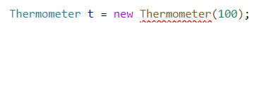

A Closer Look at Abstract Classes
An abstract class must be declared with the abstract modifier.
Abstract classes may contain fields...
public abstract class Thermometer {
private double degrees;
public Thermometer(double degrees) {
this.degrees = degrees;
}
public double getTemperature() {
return degrees;
}
public void setTemperature(
double degrees) {
this.degrees = degrees;
}
public abstract double getFreezingPoint();
public abstract double getBoilingPoint();
public abstract char getScale();
}
An abstract class cannot be instantiated using new even if it defines a constructor. Why?
…constructors...
…and concrete methods.
If you could instantiate an abstract class, what would happen when you tried to call one of the abstract methods?
An abstract class may also define zero or more abstract methods.
There is no code in those methods. What would Java execute? How would it know what to return?
Notes:
An abstract class may also define zero or more abstract methods.
WHEN YOU DON’T WANT YOUR CLASS TO BE INSTANTIATED.

Slide 39
Subclassing an Abstract Class
public class Fahrenheit
extends Thermometer {
public Fahrenheit(double degrees) {
super(degrees);
}
@Override
public double getFreezingPoint() {
return 32;
}
@Override
public double getBoilingPoint() {
return 212;
}
@Override
public char getScale() {
return 'F';
}
}

Slide 40
Subclassing an Abstract Class
A child class may subclass an abstract class using the extends keyword.
Abstract methods are used when there is no common implementation. Other child classes will implement the methods differently.
If the parent class defines any constructors, one of them must be called using super.
public class Fahrenheit
extends Thermometer {
public Fahrenheit(double degrees) {
super(degrees);
}
@Override
public double getFreezingPoint() {
return 32;
}
@Override
public double getBoilingPoint() {
return 212;
}
@Override
public char getScale() {
return 'F';
}
}
public class Celsius extends Thermometer {
public Celsius(double degrees) {
super(degrees);
}
@Override
public double getFreezingPoint() {
return 0;
}
@Override
public double getBoilingPoint() {
return 100;
}
@Override
public char getScale() {
return 'C';
}
}
The child class must provide an implementation of each of the abstract methods defined by its parent class.
If the child class does not implement one or more of the abstract methods, it must also be declared abstract.

Slide 41

3.18
An Abstract Goat
Abstract classes allow us to define behavior without implementing it. This seems like a perfect fit for some of the methods in the Goat class. Modify the Goat class so that it is abstract and convert any methods that do not have useful implementations into abstract methods.
1 public abstract class AbstractParent {
2 public abstract void aMethod();
3 }
Open the Goat class and convert it to an abstract class.
Add the abstract modifier to the class declaration.
Search through each method in the class and, if the method is not useful as implemented, convert it to an abstract method.
Add the abstract modifier to the method declaration.
Delete the body of the method.
What changes are necessary in any of the Goat child classes?
Why?
Run your code to make sure that it still works.
Artwork by Leonid Afremov
Notes:
What changes are necessary in any of the Goat child classes?
Need to implement all the abstract method

Slide 42


The Trolls
Our Goats need Bad Guys to fight! Let’s make some trolls.
Type | Hit Points | Attack | Special
Trolling | 38 | U Mad? 15 (Physical Damage) | Takes +25% Magical Damage Regenerates 3%
Trollzord | 64 | Flame War 25 (Magical Damage) | Takes +25% Holy Damage Regenerates 5%
In GvTV, trolls spawn and attack the party in waves. The number and type of trolls varies.

Slide 43
3.19
Another Simple Domain Analysis
We’ll need new classes to represent each of the Trolls. Fill in the table below to identify the state and behavior needed for each of the new enemy classes.
Things to Note:
A troll’s name is the same as its class, e.g. "Trolling".
Trolls regenerate health at the start of each round.
When a troll’s hit points reach 0, the troll is vanquished permanently.
Class | State | Behavior
Trolling
Trollzord

Slide 44
3.19
Another Simple Domain Analysis
We’ll need new classes to represent each of the Trolls. Fill in the table below to identify the state and behavior needed for each of the new enemy classes.
Things to Note:
A troll’s name is the same as its class, e.g. "Trolling".
Trolls regenerate health at the start of each round.
When a troll’s hit points reach 0, the troll is vanquished permanently.
Class | State | Behavior
Trolling
Trollzord
NAME (“TROLLING”)
MAX HP
CURRENT HP
GETTERS/SETTERS
IS VANQUISHED?
REGENERATE
ATTACK
TAKE DAMAGE
NAME (“TROLLZORD”)
MAX HP
CURRENT HP
GETTERS/SETTERS
IS VANQUISHED?
REGENERATE
ATTACK
TAKE DAMAGE
Notes:
It has additional method.

Slide 45
Software Design
Domain analysis is often the first step in software design, and we have now performed simple domain analyses a number of times.
In the past, we forged ahead and immediately began writing classes based on this initial analysis, but we now know that can lead to lots of revision.
For example, we ended up doing a lot of copying, pasting, and deleting code while implementing the first few Goat classes.
Before tackling the Trolls, let's learn from our previous mistakes and try to anticipate a more elegant design before we dive into code.
A little more time spent on an initial design can save a lot more time spent writing, revising, and rewriting code later.
Before moving forward, let's try to:
Identify potential parent classes based on common attributes among the Trolls.
Identify possible abstract methods where there is a method that every Troll needs, but there is no common implementation of the method.
How will this extra effort now save us time and effort later?
Many novice programmers (and some who are experienced) use "clean sheet coding" in which they simply start writing code in an empty file with little thought put into an up front design.
This kind of software development is perfectly fine for throwaway code; rapid prototypes or solutions to toy problems. In those circumstances, spending a lot of time on a design probably isn't worth it.
But any code that you plan to spend more than a few minutes on is worth designing up front. This can (and will) save you a lot of time, especially with OO programs that include lots of little classes.
The good news is that, over time and with practice, you will get better and faster at designing software.
And you will learn about design patterns that can act like shortcuts to a design for common problems.

Slide 46



3.20
Identifying Common Attributes
Let's iterate on our domain analysis again and try to identify common attributes between the two different types of Trolls. This will help us make the decision about whether or not we need a common parent.
 | Common to Both | Unique to Trollzord | Unique to Trolling
State
Behavior

Slide 47
3.20
Identifying Common Attributes
Let's iterate on our domain analysis again and try to identify common attributes between the two different types of Trolls. This will help us make the decision about whether or not we need a common parent.
 | Common to Both | Unique to Trollzord | Unique to Trolling
State
Behavior
NAME
MAX HP
CURRENT HP
REGEN %
?
?
CONSTRUCTOR?
GETTERS/SETTERS
REGENERATE?
VANQUISHED?
CONSTRUCTOR
ATTACK
REGENERATE?
TAKE DAMAGE
CONSTRUCTOR
ATTACK
REGENERATE?
TAKE DAMAGE
Notes:
MAX HP and REGEN is available in both Trolls but values are unique in each type of troll → Set the value in specific Troll
Behavior
Attack and Take damage also should be part of Common behavior
But regenerate, attack and take damage should be implemented in each troll. → Sign of abstraction.

Slide 48
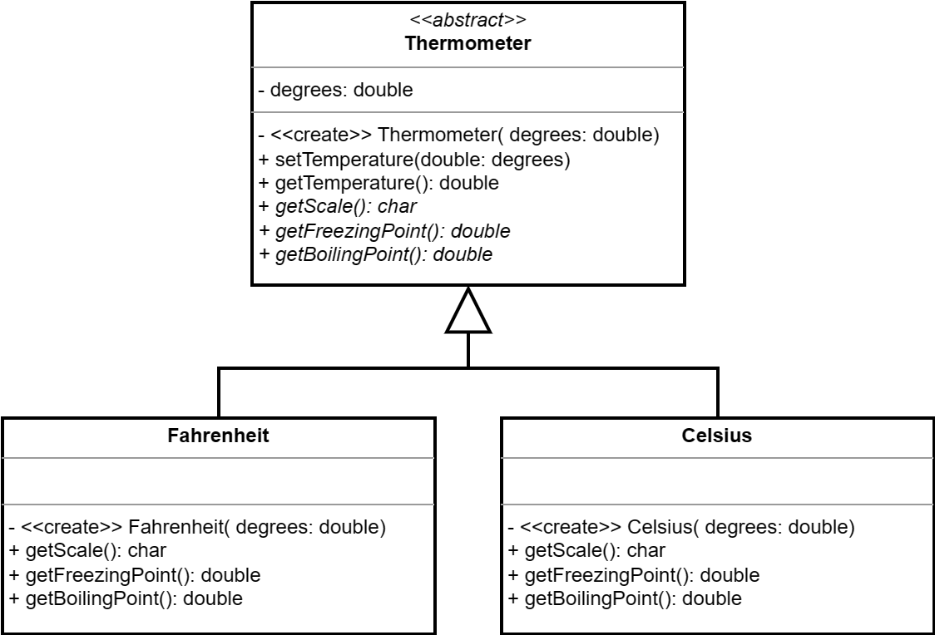
Abstract Classes in UML
Notes:
Italicized Text: The name of the abstract method is displayed in italics. This is the most common and standard UML convention.
Textual Annotation: Alternatively, the {abstract} keyword (or stereotype «abstract») can be placed after or below the method's signature if italicization is not practical.

Slide 49
Abstract Classes in UML
An abstract class in a UML diagram is indicated using the <<abstract>> annotation (in guillemets).
Italics are used to indicate that a method in the class is abstract.
If a child implements one or more of the abstract methods, they are repeated in the child class.
The same arrow used to indicate that one class subclasses another is used when subclassing an abstract class.

Slide 50
3.21
Diagramming Trolls
It is considered best practice to attempt to design your software before you start implementing it. Putting thought into the different classes that you will need, and how they are related to or associated with each other can help speed up development and save time in the long run.
Using the drawing tool of your choice, create a UML class diagram representing the Troll classes that you are about to implement.
You will need an abstract class to represent the common Troll state and behavior.
Which methods will you be able to implement?
Which should be abstract?
You will also need classes for the Trolling and Trollzord classes.
Challenge: add the DamageType enum and the Attack class to your diagram.
Be sure to connect them to the other class(es) with appropriate UML relationships.

Slide 51
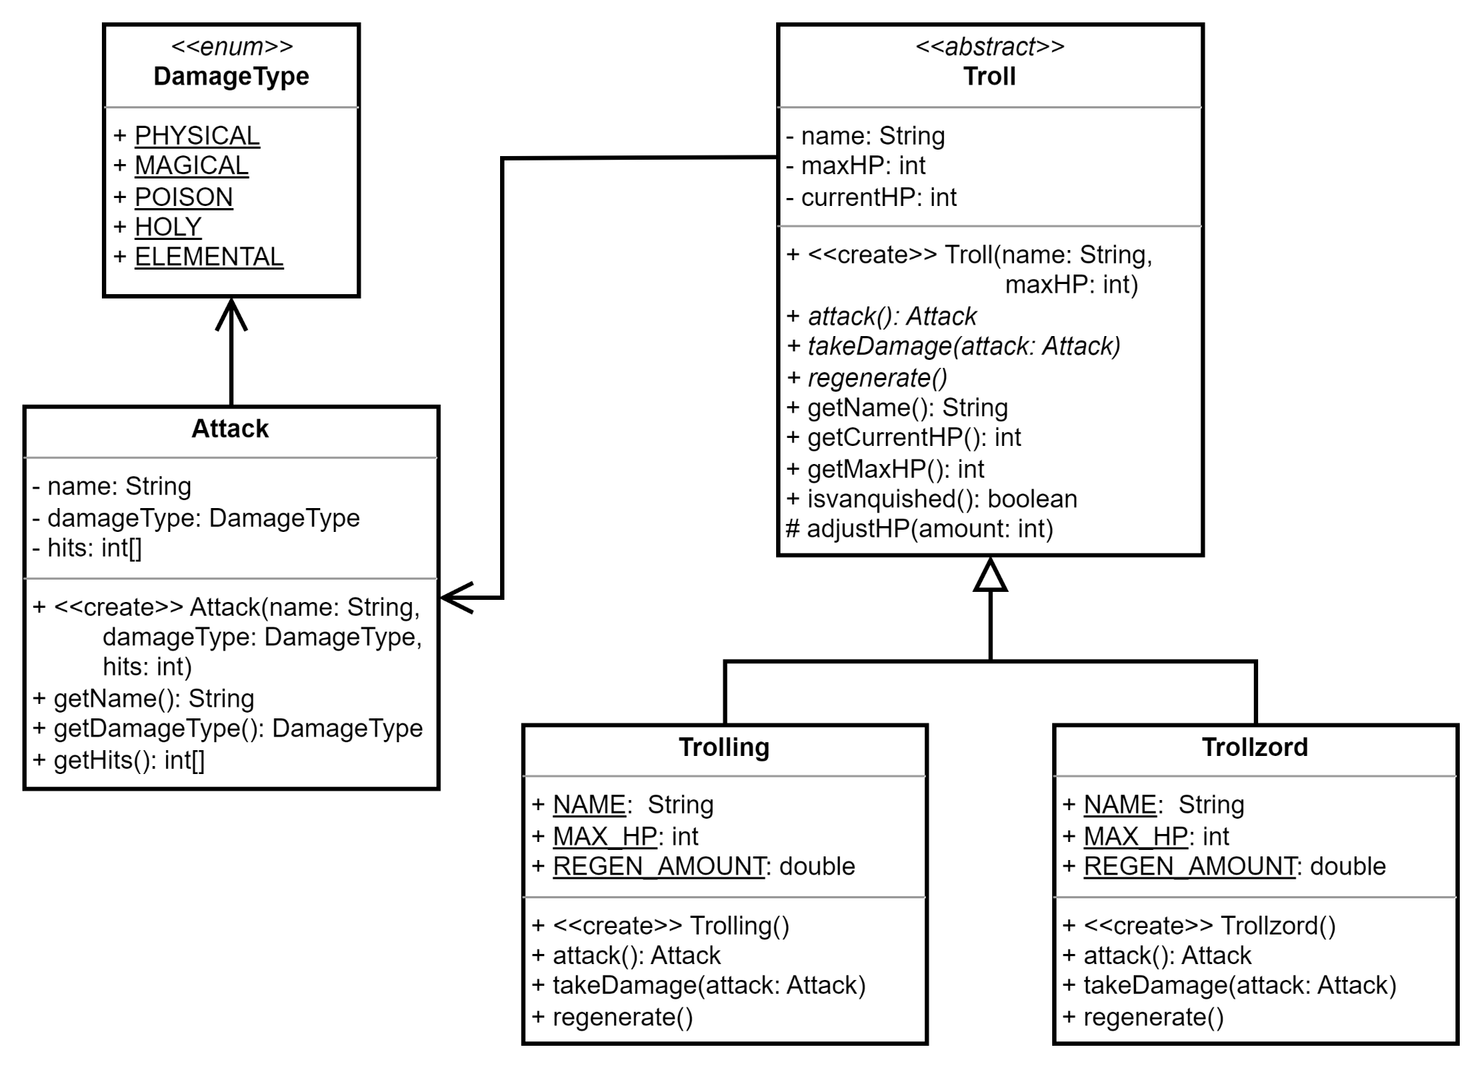

Slide 52


3.22
A Common Troll
You now have enough of a design put together to begin implementing the common Troll class. Use your UML diagram as a guide to create the class now.
Trolls are commonly found on apps like Twitter and Reddit.
Use your UML class diagram to guide you in creating a new Java class named "Troll".
Don't forget to use the abstract modifier in the class declaration.
Add any common state as fields.
Add an appropriate constructor.
Implement any common methods.
Be sure to define any abstract methods that are needed by all Trolls but do not have a common implementation.
public abstract class Thermometer {
private double degrees;
public Thermometer(double degrees) {
this.degrees = degrees;
}
public abstract double getFreezingPoint();
public abstract double getBoilingPoint();
public abstract char getScale();
}

Slide 53
3.23
The Trollzord
Now that you have a common Troll class that provides common implementations of concrete methods and defines common behavior without implementing it, you're ready to create your first subclass: the Trollzord!
public class Fahrenheit
extends Thermometer {
public Fahrenheit(double degrees) {
super(degrees);
}
@Override
public double getFreezingPoint() {
return 32;
}
@Override
public double getBoilingPoint() {
return 212;
}
@Override
public char getScale() {
return 'F';
}
}
Create a new Java class named "Trollzord". Remember that a Trollzord:
Is named "Trollzord"
Has 64 hit points
Attacks with Flame War which does 25 magical damage
Takes +25% holy damage
Regenerates 5% max health at the start of a round

Slide 54
3.24
The Trolling
Now that you have a common Troll class that provides common implementations of concrete methods and defines common behavior without implementing it, you're ready to create another subclass: the Trolling!
public class Fahrenheit
extends Thermometer {
public Fahrenheit(double degrees) {
super(degrees);
}
@Override
public double getFreezingPoint() {
return 32;
}
@Override
public double getBoilingPoint() {
return 212;
}
@Override
public char getScale() {
return 'F';
}
}
Create a new Java class named "Trolling". Remember that a Trolling:
Is named "Trolling"
Has 38 hit points
Attacks with U Mad which does 25 physical damage
Takes +25% magical damage
Regenerates 3% max health at the start of a round

Slide 55
An Expression Parser
Today we will be switching gears and implementing an expression parser.
The user is prompted to type an arithmetic expression using prefix notation.
The expression parser prints the results of evaluating the expression.
An expression may be a constant or an operator performed on one or more operands.
Each operand is another expression.
The parser should support the following unary operations (meaning that there is one operand):
Increment (++)
Decrement (--)
The parser should also support the following binary operations (meaning that there are two operands):
Addition (+)
Subtraction (-)
Multiplication (*)
Division (/)
Integer Division (//)
Exponent (**)
The operand(s) for any supported operation may be any expression, including constants, e.g.:
* 4 5 (equivalent to 4 * 5).
+ * 3 2 - 4 5 (equivalent to (3 * 2) + (4 - 5))
Most people are more familiar with infix notation, using which the operator is situated between operands, e.g. 2 + 2.
However, parsing such expressions is very challenging. One technique is the Shunting- Yard Algorithm.
Our expression parser will handle expressions written using prefix notation, using which the operator precedes its operand(s), e.g. + 2 2.
Parsing expressions written using prefix notation is significantly easier, even though they can be a little harder for humans to read.
>>> + 2 * + 3 1 - 5 2
14

Slide 56
Expressions
Let's start by focusing on the expressions that our expression parser will create.
When an expression is evaluated, the result is a single, floating point value.
There are three basic types of expressions that our expression parser will support.
A constant is a literal value, eg. 3.14159.
When a constant expression is evaluated, it always just returns its value.
A unary expression is an operator and exactly one other expression.
The other expression must be evaluated first.
Then the operator is applied to the result.
For example ++ 5 is a unary expression that evaluates the constant expression 5, and then adds one.
A binary expression is an operator and exactly two other expressions.
Both of the other expressions must be evaluated first.
Then the operator is applied to both results.
For example + 4 5 is a binary expression that evaluates two constant expressions and then adds the results together.
It can be helpful to visualize expressions as a tree. For example, take the example expression shown previously.
+ 2 * + 3 1 - 5 2
14
+
12
2
*
4
3
+
-
3
1
5
2
Each binary expression in this tree must evaluate both of its expressions before applying the operator.

Slide 57

3.25
Expression Practice
Before we start implementing our expression parser, let's practice evaluating prefix expressions by hand.
Expression | Final Result
7
++ 5.6
+ 2 3
+ ++ 2 ++ 3
+ 2 - 4 2
* + 2 3 - 5 3
+ - * 3 + 4 2 7 5

Slide 58
3.25
Expression Practice
Before we start implementing our expression parser, let's practice evaluating prefix expressions by hand.
Expression | Final Result
7
++ 5.6
+ 2 3
+ ++ 2 ++ 3
+ 2 - 4 2
* + 2 3 - 5 3
+ - * 3 + 4 2 7 5
7
6.6
5
7
4
10
16

Slide 59
3.26
Another Simple Domain Analysis
Let's start with a focused simple domain analysis and concentrate first on constants and the two unary expressions: increment and decrement.
Class
State
Behavior

Slide 60
3.26
Another Simple Domain Analysis
Let's start with a focused simple domain analysis and concentrate first on constants and the two unary expressions: increment and decrement.
Class
State
Behavior
EXPRESSION
CONSTANT
UNARY EXPRESSION?
INCREMENT
DECREMENT
?
VALUE
EXPRESSION
EXPRESSION
EXPRESSION
EVALUATE
CONSTRUCTOR
EVALUATE
CONSTRUCTOR
EVALUATE
CONSTRUCTOR
EVALUATE
CONSTRUCTOR
EVALUATE

Slide 61
A World Without Polymorphism
For many inexperienced object-oriented programmers thinking in terms of inheritance is not yet natural or automatic.
Nevertheless, it may seem clear that some kind of common parent class is needed to represent all expressions.
This will enable us to use polymorphism in our unary and binary expression classes so that they will work with any kind of expression.
However, let's take a moment and imagine a world where polymorphism doesn't exist. What would our expression classes look like then?
What would we need to do in order to make the increment expression work with any of our other expressions?
We would have no choice but to create fields for every type of expression, including constant, increment, and decrement.
Our solution would only get worse as we added new expressions to the system, e.g. addition, exponent, etc.
Every expression class would need to have fields for every type of expression!
1 public class Increment {
2 private Constant constant = null;
3 private Increment increment = null;
4 private Decrement decrement = null;
5
6 public Increment(Constant constant) {
7 this.constant = constant;
8 }
9
10 public Increment(Increment increment) {
11 this.increment = increment;
12 }
13
14 public Increment(Decrement decrement) {
15 this.decrement = decrement;
16 }
17
18 public double evaluate() {
19 if(constant != null) {
20 return constant.evaluate() + 1;
21 } else if(increment != null) {
22 return increment.evaluate() + 1;
23 } else {
24 return decrement.evaluate() + 1;
25 }
26 }
27 }
Clearly this is not scalable. So let's make sure to use inheritance and polymorphism in our design.

Slide 62
3.27
An Expression Class
Both constants and unary expressions are types of expressions that evaluate to a single value. This implies that they have some common behavior, even if the implementation of that behavior is going to be different. Create a common parent class to represent an expression.
Create a new package named "parser" and use it for all of the code that you write for the "expression parser" problem.
Create a new Java class name "Expression" in the parser package and define a method named evaluate that returns a double.
There is no possible common implementation of this method, and so it should probably be declared abstract.
public abstract class Animal {
public abstract void speak();
}
Ultimately, we'd like our expression parser to be able to work with any kind of expression.
A common expression class will allow us to use polymorphism when implementing the parser.

Slide 63
3.28
A Constant Expression
A constant is the simplest kind of expression: it always evaluates to the same value. Create a new class that implements a Constant expression.
public abstract class Animal {
public abstract void speak();
}
Create a new Java class named "Constant". When a constant expression is evaluated, it always returns its constant value.
Don't forget to extend your Expression class.
Declare a field to hold the constant value.
Implement a constructor to set the value.
Implement the evaluate method. Hint: it just returns the constant value!
Define a main method with the appropriate signature, and test your new Constant class.
public class Dog extends Animal{
private String name;
public Dog(String name){
this.name = name;
}
@Override
public void speak(){
System.out.println("Woof");
}
}

Slide 64
3.29
Increment & Decrement
Increment and decrement are both unary expressions, meaning that each is created with one operand (another expression) that must be evaluated before the final result is computed.
++
--
Create a new Java class named "Increment" and implement the increment expression.
Do not forget to extend your Expression class.
An increment expression is created with an operand that may be any other kind of expression.
When an increment is evaluated, it evaluates its operand expression and then adds 1.
Add a main method to test your new Increment class.
Repeat the above steps to create a new class that implements the decrement expression.
Unary expressions are created with some other expression. When evaluated, the unary expression first evaluates the other expression, then applies its operator.

Slide 65
3.30
Addition & Subtraction
Addition and subtraction are binary expressions. Each is created with two other expressions. Both expressions are evaluated before the operator is applied. Let's create classes to represent each of these binary expressions.
Implement a new Java class in a file named "Addition.java" and implement the addition expression.
Do not forget to extend your Expression class.
An addition expression is created with two expressions that it uses as its operands.
When evaluated, the addition expression must first evaluate both of its operand expressions before adding the results together.
Add a main method to test your new Addition class.
Repeat the above steps to create a new class that implements the subtraction expression.
+
2
-
+
-
3
1
5
2
A binary expression must evaluate both of is expression before it can compute its result.

Slide 66
Interfaces
We now have five different expression classes: Constant, Increment, Decrement, Addition, and Subtraction.
All five classes define the same behavior, but implement it differently: the evaluate method.
As with the examples in the previous parts of this unit, we recognized the need for a parent class to define this behavior so that we could leverage polymorphism to use the different types of expressions interchangeably.
But because there is no common implementation of the evaluate method that is shared by two or more classes, we declared the method abstract.
But the Expression class has no other state or behavior; it's only method is abstract.
Unlike the Goat class, which had a mix of state, and both concrete and abstract behavior.
In Java, there is an alternative to abstract classes when there is no state and only abstract behavior: the interface.
Like a class, an interface is declared in a .java file with the same name, but uses the interface keyword (rather than class).
A Java interface is very much like an abstract class that only has abstract methods.
1 public interface Animal {
2 public abstract void speak();
3 }
A class may only extend one class, but may implement many interfaces.
1 public class Dog implements Canus, Animal {
2 public void speak() { ... }
3 public void buryBone() { ... }
4 }
The class must implement all of the abstract methods in all of the interfaces that it implements.

Slide 67
Java Interfaces
A Java interface is very much like an abstract class that contains only abstract methods.
An interface may include static state and behavior as well.
An interface may not:
Include any non-static state.
Include any concrete methods.
Be instantiated using new.
Creating an interface creates a new type.
This means that an interface may be used as a variable, field, or parameter.
A class that implements an interface establishes an inheritance relationship with the interface.
The class is a instance of the interface.
This means that any code written to use the interface will work with the class! Polymorphism!
Java only supports single inheritance with respect to classes.
A class may extend at most one other class.
If the class already extends some other class, it cannot extend a second class.
But a class may implement any number of interfaces.
This means that, if an abstract class has only abstract methods, it is better to use an interface instead.
When one class extends another, it is locked in to that relationship; it cannot extend any other class.
This means that polymorphism can't be used with any other Java class.
But a class may implement any number of interfaces (specified as a comma-separated list)...
public class Implementor implements A, B, C, D {
// ...
}
When a class implements an interface, it establishes an inheritance relationship with the interface, meaning that the class can be used in place of any interface that it implements.
Given the choice, using an interface instead of an abstract class makes your design much more flexible and dramatically improves the potential for polymorphism.

Slide 68
A Closer Look at Interfaces
The first step to creating an interface is to declare it as such (rather than a class) using the interface keyword.
An interface may declare static state or behavior that is used through the interface, e.g. Animal.getKingdom()
1 public interface Animal {
2 private static final String KINGDOM = "Animalia";
3
4 public static String getKingdom() {
5 return KINGDOM;
6 }
7
8 void speak();
9 }
A class uses implements (rather than extends) to implement an interface...
public abstract
Any non-static behavior must be both public and abstract. Because of this, both modifiers are optional.
public class Dog implements Animal {
@Override
public void speak() {
System.out.println("Woof!");
}
}
public class Cat implements Animal {
@Override
public void speak() {
System.out.println("Meow!");
}
}
...and the implementing class must implement any abstract methods defined by the interface (or be declared abstract).
Notes:
One of your students may have used default methods before. If they ask, just point out that we won't be covering them in this course because they muddy the water between abstract classes and interfaces too much for students that are just learning.

Slide 69
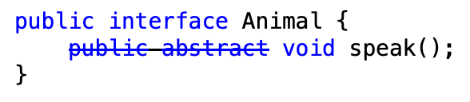
3.31
An Expression Interface
The Expression class defines only a single, abstract method. It does not have any fields, constructors, or concrete methods. There is no reason not to make it into an interface!
Open your Expression class and change it so that it is an interface rather than a class.
Change the "class" keyword to "interface".
Note that, because all methods in an interface must be both public and abstract that those modifiers are optional. You may remove them from your method declaration. This is a purely stylistic choice.
You should notice that all of your other expression classes are now flagged by VSCode as having errors.
Update your concrete expressions so that they all implement your Expression interface.
The public and abstract modifiers are optional in interfaces. It's a stylistic choice whether or not to include them.

Slide 70
class vs. abstract class vs. interface
Feature | Class | Abstract Class | Interface
May be instantiated using new.
May include static state and behavior.
May include non-static state.
May define one or more abstract methods.
Must implement inherited abstract methods.
May implement concrete methods.
May extend exactly one other class.
May implement zero or more interfaces.
✔ | ✘ | ✘
✔ | ✔ | ✔
✔ | ✔ | ✘
✘ | ✔ | ✔
✔ | ✘ | ✘
✔ | ✔ | ✘
✔ | ✔ | ✘
✔ | ✔ | ✘
Notes:
You may want to note that one interface may extend another.

Slide 71
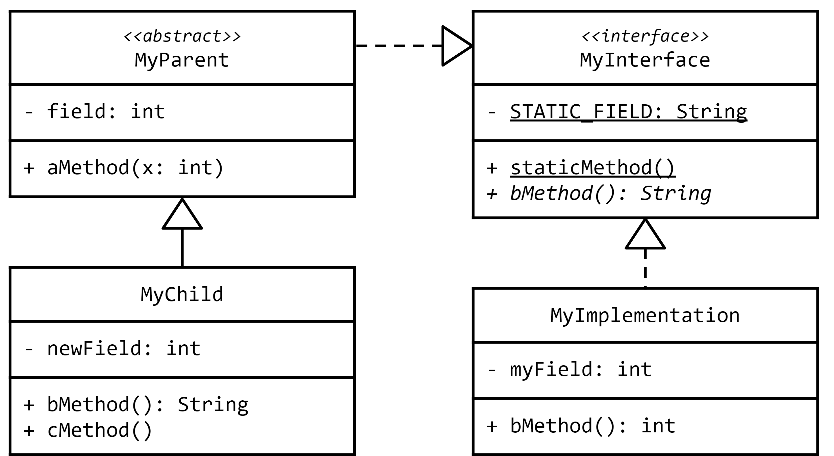
UML
(with Interfaces)

Slide 72
UML
(with Interfaces)
An abstract class does not need to implement any methods inherited from an interface...
An interface is often marked with an <<interface>> tag above or below its name.
Implementation (also called "realization") is shown with a closed, unfilled arrowhead and a dashed line (---).
...but the responsibility is then passed onto any concrete children that extend the abstract class.
A class that implements an interface must implement the interface's methods (or be declared abstract).

Slide 73


Summary & Reflection
What is one thing that you wish you knew more about as we move forward?
Simple Domain Analysis
Basic Inheritance
extends
overriding
Polymorphism
Abstract Classes
abstract methods
extending
UML Class Diagrams
Interface Inheritance
implements
What is one new thing that you learned today?
What one question do you have about today’s class?
Please answer the questions above in your notes for today.

